Slide 1
PREPARED BY:- PALAVI PATIL
BHARGAVI JAHARGIDAR
SARANSH SINGH
SHOUKATH ALI
PROJECT:- P_groupN_HCDR_16
HOME CREDIT DEFAULT RISK CLASSIFICATION USING MACHINE LEARNING TECHNIQUES

Slide 2
Sections
Team Photos
Description
Project Flow
Past
Present
EDA
Top Features
Modeling Pipelines
Neural Network
Result and Discussion
Kaggle Score and submission
Conclusion

Slide 3

Team Photo
PALAVI PATIL
BHARGAVI JAHAGIRDAR
SARANSH SINGH
SHOUKATH ALI
Group Name:-
FP_groupN_HCDR_16

Slide 4
Description
As part of this project, we aim to address and solve the challenge of predicting loan repayment by leveraging alternative data sources.
We aim to create innovative predictive models that will not only benefit Home Credit but also contribute to improving the overall lending industry.
By harnessing the power of diverse data and cutting-edge machine learning techniques, we strive to make a meaningful impact in ensuring that people with limited or no credit history can access loans more easily and enjoy a positive borrowing experience.

Slide 5
Project Flow
Model score
Problem Statement
Data Collection
Data processing
EDA
Data wrangling
Data preprocessing (using pipelines)
Feature Selection/engineering
Build ML models
Tuning Hyperparameters
Model Evaluation

Slide 6
Past
The HCDR competition focuses on the task of predicting whether a client will repay a loan or not.
Its main goal is to ensure that individuals with difficulty obtaining loans due to their limited or non-existent credit histories can have a better loan experience.
The nature of our project (classification) is based on handling huge chunk of data, doing data analysis, preprocessing , applying machine learning algorithms.
In Phase two of our project as per our flow diagram, we started doing exploratory data analysis on our data files which were application_train, application_test, previous_application, bureau etc.
After completing the EDA work, we did feature engineering in phase 2.
Based on the best relevant features we deployed different machine learning models such as Logistic Regression, SVM and test model accuracy.
To refine the model with more optimal results, we performed Hyper Parameter Tuning with different parameter values.
We built multiple pipelines for numerical data, categorical data and classifiers.

Slide 7
Present
In this phase, we implemented Neural Network to increase the accuracy.
First, we implemented the baseline model using Logistics Regression, where we observed that data is unbalanced.
To overcome this, we have used Random Forest in which we have used hyper-parameter tuning.
After this, we experimented with 2 different neural network architectures. We are getting accuracy of 91 percent in Neural Network.
We also checked if there any data leakage. This was tested by splitting our train data into train and test set. Here, we found out that the accuracy of this test set is more than the original test data which implies that there is a data leakage.

Slide 8
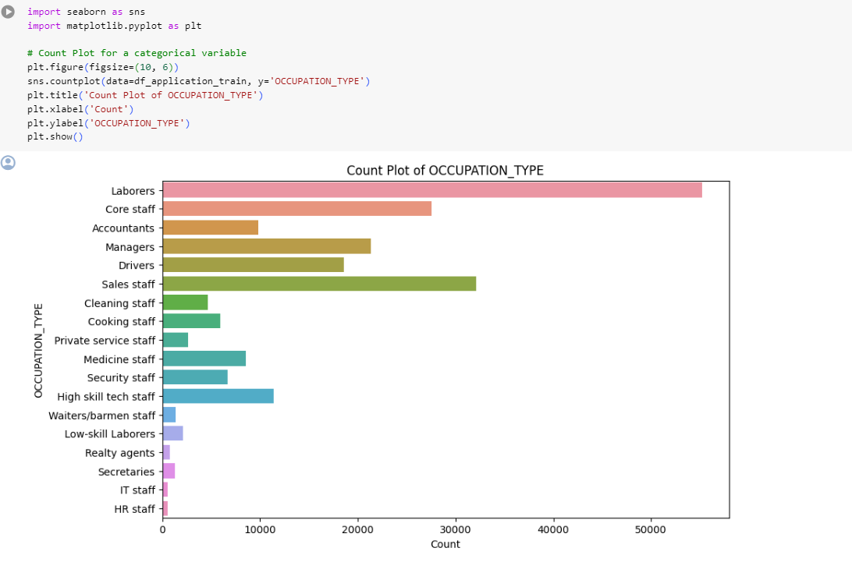
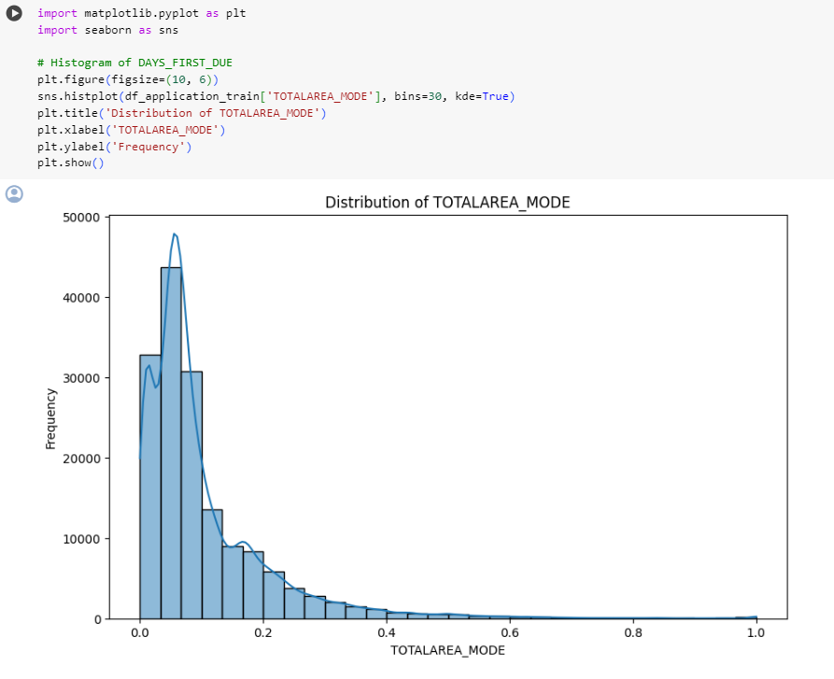
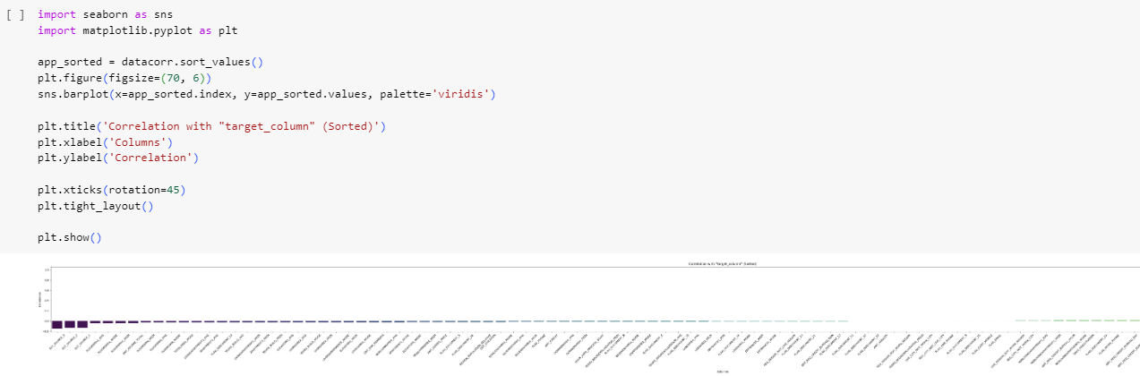
EDA

Slide 9
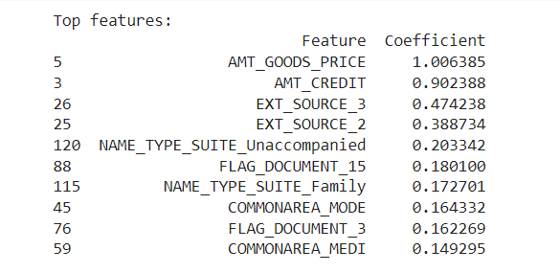
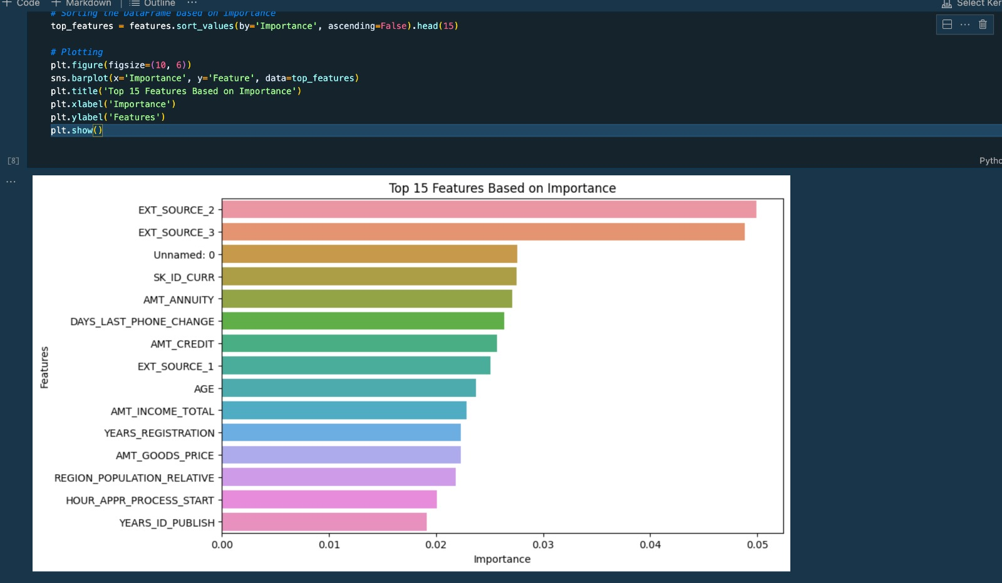
Top Features

Slide 10
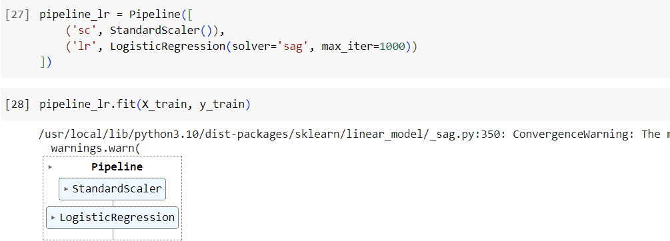
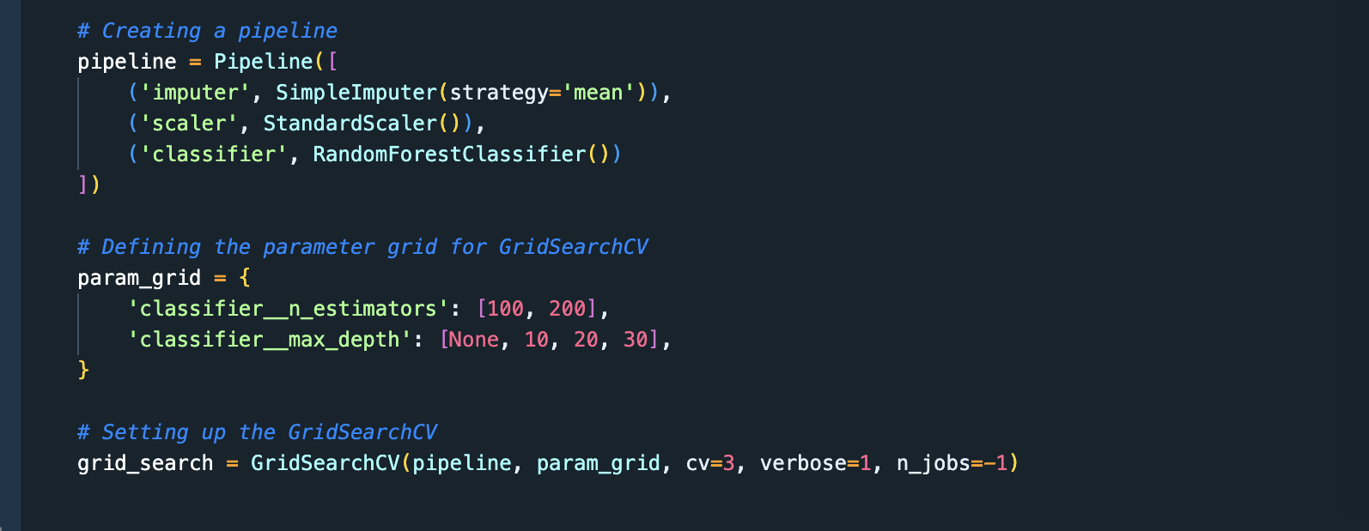
Modeling Pipelines Screenshots

Slide 11
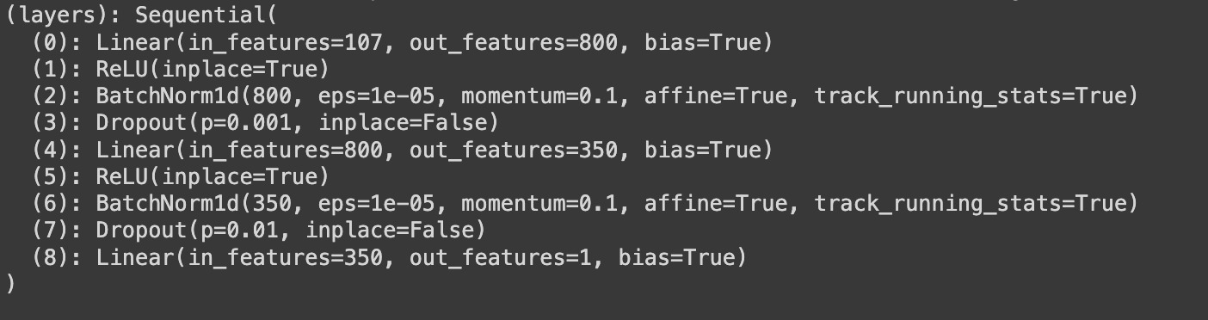
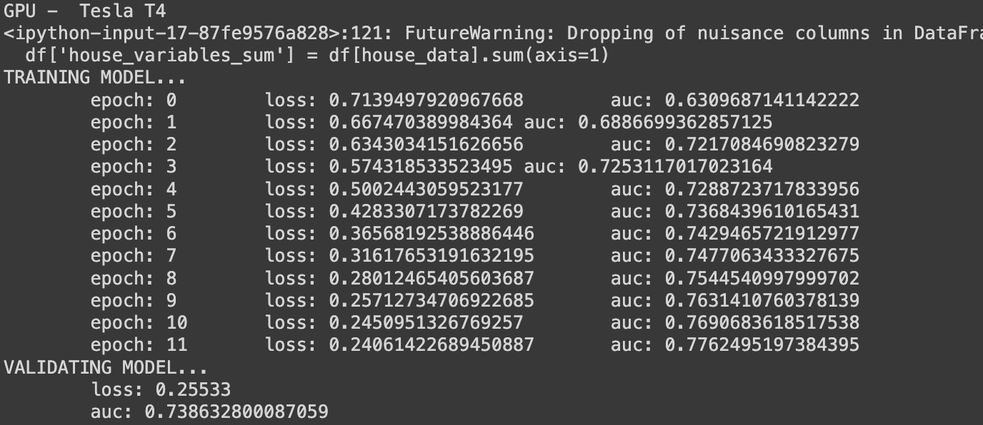
Neural Network

Slide 12
Overview of Modeling Pipelines explored
We have explored a few pipelines for our numerical and categorical data
Simple Imputer and Standard Scalar are used for the numerical data
OneHotEncoder is used to handle categorical data.
Different pipelines are created for different models after handling the numerical and categorical data

Slide 13
Results
# | Model | Accuracy |  | F1 Score |  | AUC | Precision |  | Recall
1 | Logistics Regression | 91.7 |  | Class | Score | 50.7 | Class | Score | Class | Score
 |  |  |  | 0.0 | 0.96 |  | 0.0 | 0.92 | 0.0 | 1.00
 |  |  |  | 1.0 | 0.03 |  | 1.0 | 0.51 | 1.0 | 0.02
2 | Random Forest | 91.9 |  | Class | Score | 71.0 | Class | Score | Class | Score
 |  |  |  | 0.0 | 0.96 |  | 0.0 | 0.92 | 0.0 | 1.00
 |  |  |  | 1.0 | 0.00 |  | 1.0 | 0.83 | 1.0 | 0.00
3 | Neural Networks | Arch. | Score | 0.0263 | Score | 74 | 0.4278 | Score | 0.0132 | Score
 |  | 1st | 91 | 0.0 |  |  | 0.0 |  | 0.0
 |  | 2nd | 91 | 1.0 |  |  | 1.0 |  | 1.0

Slide 14
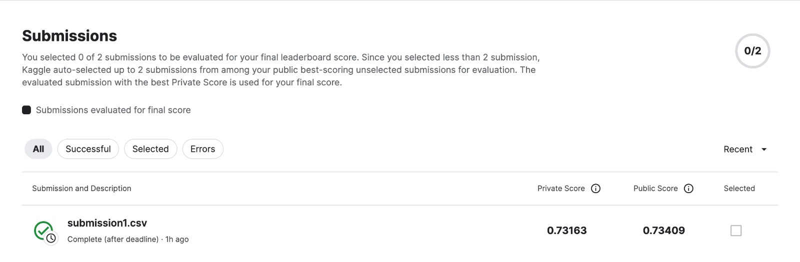
Kaggle Score and Submission

Slide 15
Conclusion
From the various models implemented, we achieved the following accuracies for the following: Random Forest Classifier: 91.9 % , Logistic Regression: 91.7 % , Neural Networks: 91 % Classifier achieved the highest accuracy. To solve the Home Credit Default Risk Prediction, using feature engineering, we can see that .. performed the best and provided optimal accuracy

Slide 16
Problems
We faced a problem with runtime for SVC ML model.

